Slide 1
LPG GAS LEAKAGE DETECTOR (batch 3)
a.Charan sai (21r21a0569)
e.Ranadheer (21r21a0585)
g.Arnitha (21r21a0586)
g.Riya (21r21a0594)

Slide 2
abstract
There have been many incidents like explosions and fires due to LPG gas leakage. Such incidents can cause dangerous effects if the leakage is not detected at an early stage.
IOT LPG leakage detector project using Arduino is a project which will help in determining gas leakage in the surroundings and send data to an IOT module. This alert system can be used in modern buildings, schools, hotels, etc.
IOT and Arduino based LPG leakage detection system senses the LPG gas with the help of an LPG gas sensor. In this project, we will implement the LPG gas sensor interfacing with Arduino. The Signal from this sensor will be sent to the Arduino microcontroller The microcontroller is connected to an LCD, Buzzer, and IOT module .
Once the gas leakage is detected the green LED glows otherwise yellow LED will glow .

Slide 3
hardware and software required
ARDUINO UNO
MQ-6 gas sensor
10K potentiometer
16X2 LCD module
Red and green LEDs
Jumper wires and a breadboard
220 ohms resistors
USB cable for uploading the code.

Slide 4
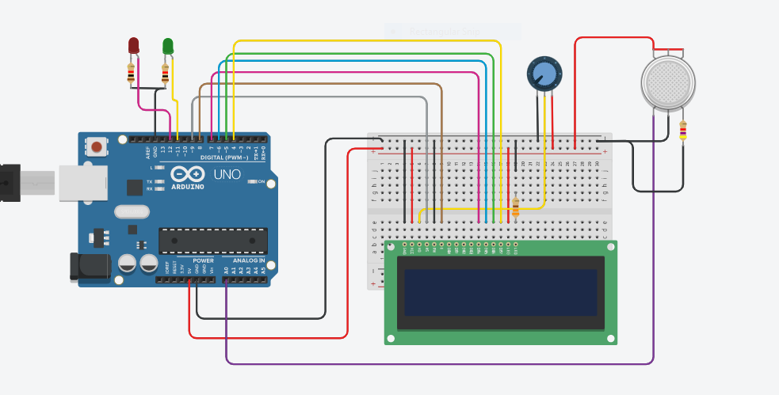
process to connect the leakage detector
First, let us connect the MQ-6 gas sensor with Arduino.
So you have to join the VCC pin of the gas
sensor with the 5 volts pin of the Arduino.
Then attach the GND pin of the gas sensor
with the GND pin of the Arduino.
Connect the OUT/A0 pin of the MQ-6 gas
sensor with the analog-0 pin of the Arduino.

Slide 5
Process to connect the leakage detector
Now make the connections between the 16×2 LCD and the digital pins of the Arduino as shown in the diagram.
After that connect the positive leg of the green LED with the digital- pin of the Arduino.
Join the positive leg of the red LED with the digital- pin of the Arduino.
At last, connect the negative legs of both the LEDs with the GND pin of the Arduino via a 220 ohm resistor.
Our circuit is complete now.

Slide 6
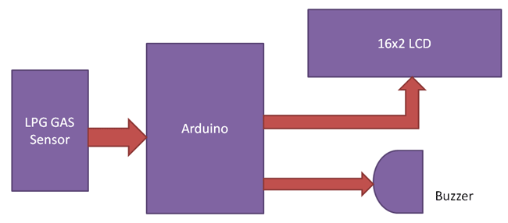
flow diagram

Slide 7
languages used
It uses languages such as C and C ++,. Gas Sensor: Gas Sensor (MQ5) module is useful for gas leakage detection (in home and industry). It is suitable for detecting H2, LPG, CH4, CO, Alcohol. Due to its high sensitivity and fast response time, measurements can be taken as soon as possible.
But in these case we are using iot based.

Slide 8
applications
Domestic gas leakage detector.
Industrial combustible gas detector.
Portable gas detectors.
Hotels and gas cars.
Factories.
For the detection of flammable and dangerous gases and loss of oxygen.

Slide 9
CONCLUSION
Gas leakage leads to severe accidents resulting in material losses and human injuries. Gas leakage occurs mainly due to poor maintenance of equipment and inadequate awareness of the people. Hence, LPG leakage detection is essential to prevent accidents and to save human lives. This paper presented LPG leakage detection and alert system. This system triggers LED and buzzer to alert people when LPG leakage is detected. This system is very simple yet reliable.

Slide 10


